Slide 2
Promoting Innovation and Competition in Biotechnology
Nael Thaher, PhD
September 25, 2018

Slide 3
Joseph Schumpeter (1934):
“innovation… the carrying out of new combinations… is the key to entrepreneurial profits… [innovation] is the only way to create new economic value over the long term”
J.A.Schumpeter, “The Theory of Economic Development”, 1934

Slide 4
Intellectual Property Rights & Innovation
Innovation: knowledge-rich economic & social phenomena… (Rogers 2003)
Innovation = invention + commercialization
Why does IP matter? whether IPRs enhance innovation and provide incentives for innovation & technological diffusion. IPRs as a stimulator for innovation (biotechnology sector) (Castle 2009)

Slide 5
Patents play an important role in spurring innovation and investment in innovation. They contribute to the dissemination of information throughout an economy (Granstrand 2005)
Innovation and commercialization are causal relationship and can be fostered or stymied by strong IPRs

Slide 6
Fostering Innovation
Vigorous competition
Strong R&D
Strong education at all levels
Sound policies promoting science and innovation
Efficient and transparent regulatory systems
IP laws, regulations and guidelines

Slide 7
His Majesty King Abdullah II
“The need to increase investment in scientific research and support innovative and creative Jordanians”
A visit to JUST in November 2010, Kingabdullah.jo

Slide 8
The former president Obama on the Importance of Science
“Science is more essential for our prosperity, our security, our health, our environment, and quality of life than it has ever been before”
Barak Obama, National Academy of Sciences, April 2010

Slide 9
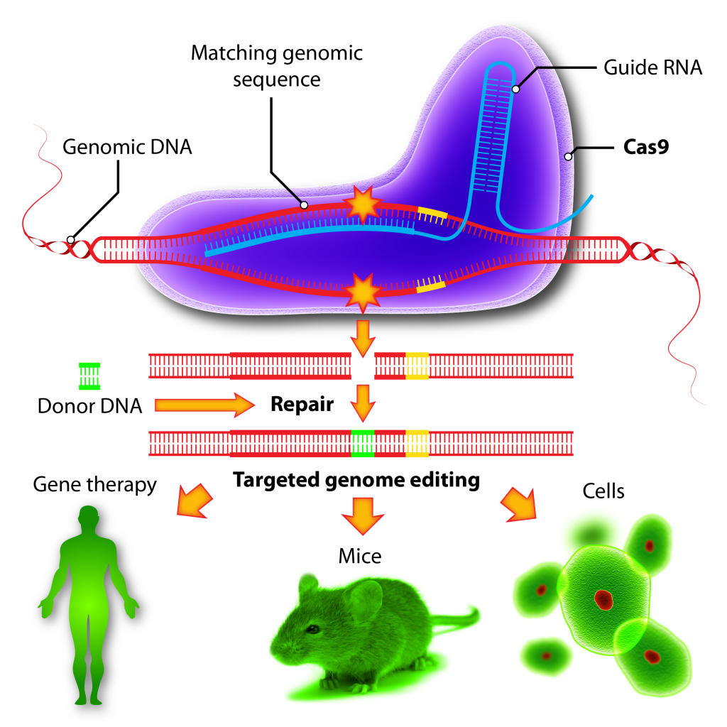
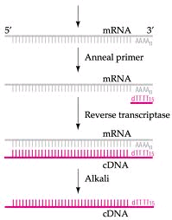
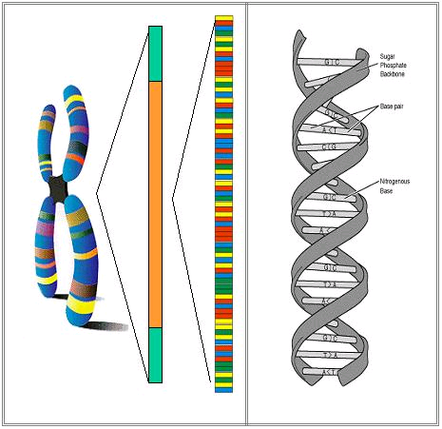
Biological Information
Gene-Editing Technology
CRISPR CAS9
Protein formation
cDNA
Gene

Slide 10
The Importance of CRISPR CAS9
Human Health
New Materials
Drug Development
Research Applications
Agriculture
Bioenergy

Slide 11
The advent of biotechnology such as developing crops that are modified with specific traits has contributed to agricultural productivity and genetic diversity
The level of research investment in biotechnology is directly related to the effectiveness of the IP protection available

Slide 12
Technology Commercialization: An Interdisciplinary Field
Scientific Discovery
Intellectual Property or Patents
Commercialization

Slide 13
Technology Transfer & Public-Private Partnerships
The Bayh-Dole Act (USA) 1980: allowed private industry to license & develop products from publicly funded research (Nugent & Keusch, 2007)
The result was the first generation of biotech hubs: the San Francisco Bay area, the greater Boston area, Research Triangle Park in North Carolina, and Oxford and Cambridge in the UK
This model became clear in the 1980s and 1990s, the model spread to Europe and Japan

Slide 14
Technology Transfer Routes
Industry-University sponsored research dollar
Licensing the technology to the private sector
Spin-off company
Open innovation (no more doing R&D alone, but partner with other companies)

Slide 15
Towards a Conceptual Framework for IP Management
Key dimensions of IP management
Collaboration
Capacity development
Incentives
Protection & enforcement

Slide 16
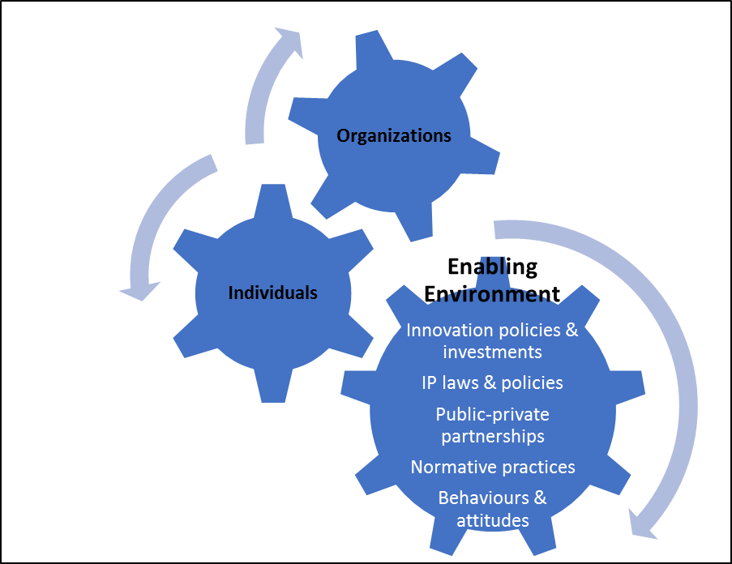
Capacity Development

Slide 17
FINAL MESSAGE
There are some organizations in Jordan that are leading, supporting and enhancing IP, technology transfer and business development. However, there is no apparent community of practice among them
Efforts are required to strengthen capacity development in the area of IP for innovation
Universities need to be aware of the importance of a strong and clear IP policy and capacity within their institutions

Slide 18
Thank You!
Nael Thaher, PhD
Email: n1thaher@gmail.com

